Slide 1
Skills Bootcamp Classroom Rules
Be on time: Just like in a physical classroom, it's important to be punctual for your online class. Log in to the virtual classroom a few minutes before the class starts.
Turn Cameras on: In order to maximise your learning studies show that being able to see your peers and your tutor being able to see you can increase motivations and retention, therefore we ask to keep your cameras on.
Attend all classes: In order to be successful in your bootcamp studies you need to attend all live sessions, therefore you should prioritise and make time for these sessions.
Avoid distractions: Turn off your phone notifications, close any other unnecessary tabs, and focus solely on the class.
Participate actively: It's important to be an active participant in the class. Ask questions, answer questions, and participate in discussions.
Use proper language and tone: Use respectful language and tone when communicating with your classmates and instructor. Avoid using slang or inappropriate language.
Respect others' opinions: Be respectful of others' opinions, even if they differ from your own. Avoid making negative comments or attacking others.
Follow the instructor's guidelines: Follow the instructor's guidelines, such as submitting assignments on time.
Be polite: Be polite and respectful to everyone in the class, including the instructor, classmates, and guest speakers.
Dress appropriately: Even though you are not in a physical classroom, it's important to dress appropriately. Dress as if you were going to a face-to-face class.
Use appropriate technology: Ensure that you have the necessary equipment, such as a reliable internet connection, a microphone, and a webcam, and that they are in good working condition.

Slide 2
Software Developer Bootcamp
Unit 1 – Introduction to Software Development
Week 2B

Slide 3
Learning Outcomes
Following this session, you should be able to:
Understand the Basic Components of Software Architecture
Understand different data types
Differentiate Between Various Software Architecture Patterns
Evaluate the Impact of Architecture Elements on Software Quality

Slide 4
Basic Components of Software Architecture

Slide 5
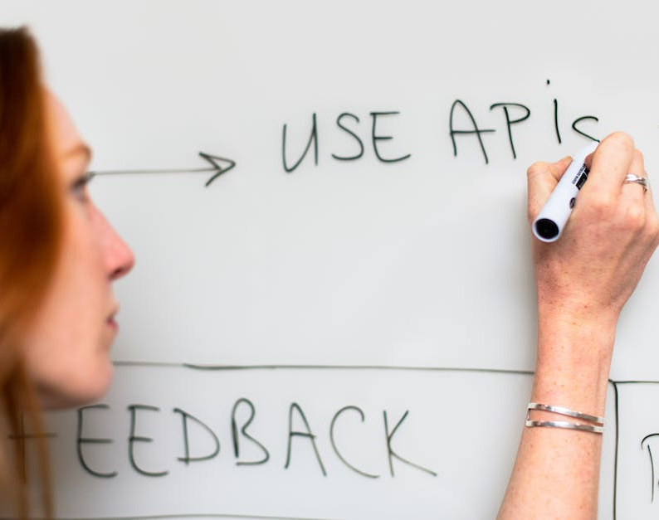
Software Architecture
What is software architecture?
What are the components of software architecture?
Benefits of software architecture

Slide 6
Software Architecture
What is Software Architecture?
- Definition: Software architecture is the high-level blueprint of a software system, providing the structure, components, and guidelines for development.
- Purpose: It serves as the "master plan" for software development teams, guiding decisions related to technology, design, and coding practices.
-Scope: Addresses critical concerns like scalability, maintainability, performance, and security.
-Vision: Sets the long-term direction for a software project, aiding in future decisions and development phases.

Slide 7
Software Architecture
Components of Software Architecture
- Components: Reusable modular parts of the system with well-defined interfaces.
- Connections: The relationships between components, often implemented through APIs or data flow mechanisms.
- Constraints: Rules and guidelines to adhere to during development, such as language or platform restrictions.
- Data Models: Definitions of how data is stored, accessed, and managed within the system.
- Middleware: Software layers that facilitate communication and data management between components.
- Architectural Patterns: Reusable solutions for commonly occurring problems, like MVC (Model-View-Controller) for UI development.

Slide 8
Software Architecture Overview
Benefits of Software Architecture
- Maintainability: Easier to understand, modify, and extend the codebase.
- Scalability: Designed to grow and adapt to changing needs.
- Performance: Optimized data flows and computational logic for faster execution.
- Reliability: Clear architecture makes it easier to debug and ensures system robustness.
- Cost-Efficiency: Streamlined development processes, reducing time and resource requirements.

Slide 9

Software Design
What is software design?
What are the components of software design?

Slide 10
Software Design
What is Software Design?
Blueprint: Consider it as the architectural plan before building a house.
Decision-Making involves making key decisions about how to structure, plan, and implement your software.
Abstraction: Focusing on what the system should do rather than how it should do it.
Responsibility Distribution: Determines how tasks and features are allocated across different pieces of software within a system.
Future-Proofing: A well-designed software is easier to maintain, extend, and scale.

Slide 11
Software Design
Components of Software Design
Architecture: High-level structure that defines the system components and their relationships.
Data Models: Define storing, accessing, and managing data.
Algorithms: Detailed steps or processes that solve specific problems within the system.
Interfaces: Defines how different software components will interact with each other and with users.
User Experience (UX): Design aspects focusing on the interaction between the user and the system.
Protocols & Standards: Guidelines for communication between system components or with external systems.

Slide 12
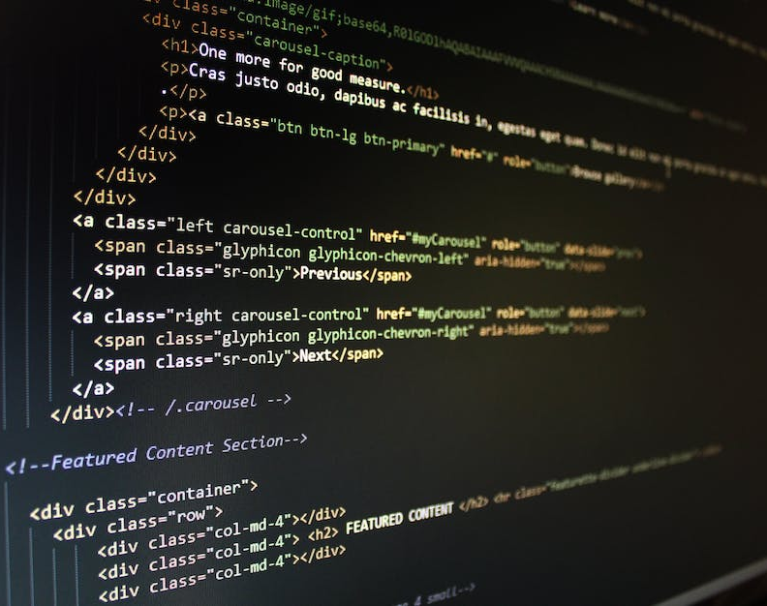
Software Requirements
What are software requirements?
What are the components of software requirements?

Slide 13
Software Requirements
What are Software Requirements?
- Definition: Software requirements are the formal specifications that describe what a software system should do and how it should perform it.
- Importance: They serve as the blueprint for system design, implementation, and testing.
- Types: Broadly categorised into functional requirements (what the system should do) and non-functional requirements (how well the system should do it).

Slide 14
Software Requirements
Components of Software Requirements
- Functional Requirements
- Use Cases: Detailed scenarios that outline the steps to achieve a specific goal.
- Data Needs: What kind of data the system will use, store, or manipulate?
- Non-Functional Requirements
- Performance: Metrics like response time, throughput, etc.
- Scalability: How well the system can adapt to increased loads.
- Security: Measures to protect data and system integrity.

Slide 15
Software Requirements
Components of Software Requirements
- Constraints
- Regulatory: Must follow laws or standards (e.g., GDPR).
- Technical: Limitations like platform dependencies, languages, or libraries.
- Quality Attributes
- Usability: How user-friendly the application is.
- Reliability: The degree to which the system is fault-tolerant.
- Documentation
- SRS Document: The Software Requirements Specification document formalises all these components.
- User Stories: Agile methodologies might use user stories to document requirements in a less formal manner.

Slide 16
Software Implementation
What is Software Implementation?
- Definition: The process of executing a plan to convert a software design into operational software.
- Phases: Encompasses coding, testing, debugging, and installation.
- Goal: To meet the functional and performance specifications laid out in the design documentation.
- Collaboration: Often involves multi-disciplinary teams, including software developers, QA testers, UX/UI designers, and system administrators.
- Lifecycle: Part of the larger software development lifecycle (SDLC), usually following the design phase and preceding the maintenance phase.

Slide 17
Software Implementation
Components of Software Implementation
- Source Code: Actual lines of code written to perform the tasks outlined in the software design.
- Libraries and Frameworks: Pre-existing code packages that provide reusable functionality, enhancing efficiency and maintainability.
- Data Models: Schemas defining how data is stored, accessed, and managed within the software.
- APIs: Interfaces allowing the software to communicate with other systems.
- Environment: The hardware and software context in which the application will run.

Slide 18
Software Implementation
Components of Software Implementation
- Testing Suites: Automated and manual tests to validate that the code meets specified requirements.
- Version Control: Systems like Git that track changes, allowing for collaboration and rollback if necessary.
- Deployment Tools: Scripts, containers, or other tools that assist in moving the software into a live environment.
- Documentation: Internal comments and external guides explaining the software's operation, aiding future development and troubleshooting.

Slide 19
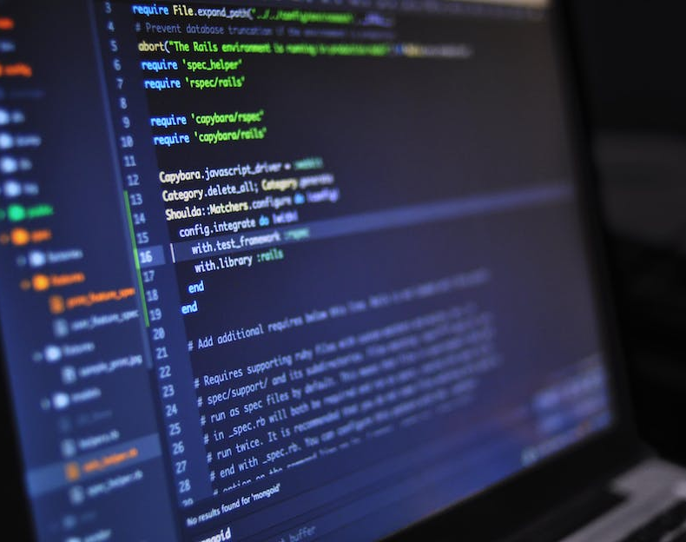
Software Testing
What is software testing?
What are the components of software testing?

Slide 20
Software Testing
What is Software Testing?
- Purpose: Evaluate and verify that software is bug-free and meets requirements.
- Goals: Identify defects and ensure functional and non-functional compliance.

Slide 21
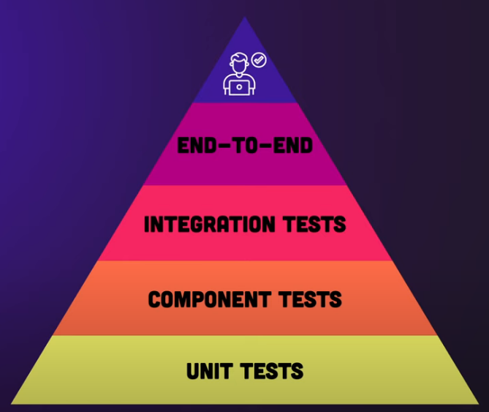
Software Testing
Components of Software Testing
- Test Plan: Strategy and scope for testing.
- Test Cases: Specific conditions for evaluation.
- Test Data: Inputs for test cases.
- Test Environment: Configured setting for tests.
- Test Execution: Running the test cases.
- Test Results: Outcomes and defect identification.
For more details: https://youtu.be/YaXJeUkBe4Y

Slide 22

Software Maintenance
What is software maintenance?
What are the components of software maintenance?

Slide 23
Software Maintenance
What is Software Maintenance?
- Definition: Software maintenance is the process of updating, modifying, and enhancing existing software after its initial deployment.
- Necessity: Ensures that software remains functional, secure, and relevant in changing environments.
- Lifespan: Often constitutes the longest phase in the software development life cycle (SDLC).

Slide 24
Software Maintenance
Components of Software Maintenance
Corrective Maintenance:
- Fixes bugs and errors that were not discovered during the initial development phase.
Adaptive Maintenance:
- Adjusts software to accommodate changes in the external environment, such as OS updates.
Perfective Maintenance:
- Adds new features or improves existing ones based on user feedback and requirements.
Preventive Maintenance:
- Proactively optimises and restructures code to prevent future issues, enhancing maintainability.

Slide 25
Existing Software Architecture Elements

Slide 26

Software Architecture Components
User Interface
Business Logic
Data Access Layer
Data Storage Layer

Slide 27
Software Architecture Components
User Interface
- Intuitive design for easy navigation.
- Responsive across devices.
- Implement accessibility features.
Business Logic
- Modular and testable code.
- Use RESTful APIs or GraphQL.
- Implement caching and security.

Slide 28
Software Architecture Components
Data Access Layer
- Use ORM for database interactions.
- Optimized queries.
- Implement connection pooling.
Data Storage Layer
- Choose the right database type.
- Implement data normalisation for SQL.
- Ensure backup and security measures.

Slide 29
User Interface
Definition of User Interface
- The point of interaction between users and digital products, using elements like buttons, menus, and graphics.

Slide 30
User Interface
Types of User Interface
- GUI: Graphics and icons-based, common in apps.
- CLI: Text-based commands used by developers.
- TUI: Resembles GUIs but with keyboard control.
- Natural Language: Uses human language, e.g., voice assistants.
- Touch: Designed for touchscreens.
- Virtual Reality: Interaction in 3D space.
- Gesture-Based: Uses physical movements as commands.

Slide 31
User Interface
Benefits of User Interface
- Improves usability and task completion.
- Increases user satisfaction and loyalty.
- Boosts efficiency and speed.
- Ensures accessibility to diverse users.
- Elevates business value and competitiveness.
- Reduces support costs.

Slide 32
Business Logic
Definition of Business Logic
- Business logic refers to the rules, calculations, and processes that handle the data exchange between a database and a user interface.
- Essentially, it's the "brain" of the application, determining how data is transformed or calculated and then passed on to the next tier in the software architecture.
Types of Business Logic
- Validation Logic: Checks for accuracy and completeness of data.
- Calculation Logic: Performs calculations, often involving multiple data points.
- Workflow Logic: Manages the sequence of steps required to complete a business process.
- Authorization Logic: Determines who has access to what within an application.

Slide 33
Business Logic
Benefits of Business Logic
- Consistency: Ensures that all data operations are consistent across different parts of the application.
- Reusability: Once defined, business logic can be reused across different systems or modules, improving development speed.
- Maintainability: Isolating the business logic makes it easier to update or modify rules without affecting other parts of the system.

Slide 34
Data Access Layer
Definition of Data Access Layer
- A separate layer in a software application that interacts directly with the database or data source.
- Responsible for CRUD operations (Create, Read, Update, Delete) on data.
- Serves as an abstraction between the business logic and database, enabling code reusability and maintainability.

Slide 35
Data Access Layer
Definition of Data Access Layer
- A separate layer in a software application that interacts directly with the database or data source.
- Responsible for CRUD operations (Create, Read, Update, Delete) on data.
- Serves as an abstraction between the business logic and database, enabling code reusability and maintainability.

Slide 36
Data Access Layer
Benefits of Data Access Layer
- Decoupling: Isolates database code from business logic, making system changes easier.
- Reusability: Enables reusing data access logic across multiple projects or modules.
- Maintainability: Easier to manage and update, saving development time in the long run.
- Security: Centralized data operations allow for better security practices, like parameterised queries to prevent SQL injection.
- Testability: Simplifies the process of writing unit tests for the business logic by mocking the data access layer.

Slide 37
Data Storage Layer
Definition of Data Storage Layer
- A component in a software architecture responsible for managing how data is stored, retrieved, and manipulated.
- Serves as the foundation for data operations in an application, abstracting the underlying storage mechanisms.

Slide 38
Data Storage Layer
Types of Data Storage Layer
- Relational Databases: SQL-based storage like MySQL, PostgreSQL.
- NoSQL Databases: Document-oriented (MongoDB), Key-Value stores (Redis), Wide-column (Cassandra).
- File Storage: File systems object storage like AWS S3.
- In-Memory Storage: RAM-based stores, e.g., Redis.
- Data Warehouses: BigQuery, Snowflake, optimised for analytics.
- Graph Databases: Neo4j, optimized for relationship-heavy queries.

Slide 39
Data Storage Layer
Benefits of Data Storage Layer
- Abstraction: Simplifies application logic by managing data operations.
- Scalability: Easier to scale the storage independently from the application.
- Consistency: Centralizes data management, aiding in data integrity.
- Flexibility: Allows for easy switching between different storage options.
- Security: Centralized control over data access and encryption.

Slide 40
Make a prediction (think, write, pair, share)
1
2
3
print("What is your name?")
name = input()
print(f"Hello {name}")
Question .
Take a look at these three lines of code.
What do you think each line of code will do when executed?
What would be the output of line 3?

Slide 41
Walking through the code
1
2
3
print("What is your name?")
name = input()
print(f"Hello {name}")
State .
Input/Output .

Slide 42
Walking through the code
1
2
3
print("What is your name?")
name = input()
print(f"Hello {name}")
State .
Input/Output .
What is your name?

Slide 43
Walking through the code
1
2
3
print("What is your name?")
name = input()
print(f"Hello {name}")
State .
name
Input/Output .
The name variable is initialised and assigned with the user input.
What is your name?

Slide 44
Walking through the code
1
2
3
print("What is your name?")
name = input()
print(f"Hello {name}")
State .
name
Input/Output .
The name variable is initialised and assigned with the user input.
What is your name?
Rebecca

Slide 45
Walking through the code
1
2
3
print("What is your name?")
name = input()
print(f"Hello {name}")
State .
name
"Rebecca"
Input/Output .
Hello is displayed on the screen with the text that was input and held in the name variable.
What is your name?
Rebecca
Hello Rebecca

Slide 46
Question
How could you use inputs to improve your silly story programs?

Slide 47
Improve your own silly stories
Open your silly stories from last lesson and add the input and print statements required to make your program more interactive.
Code reminder
print("Enter a colour :")
colour = input()

Slide 48
Types of data
Most programming languages will require a variable to be declared before it is used.
Declaring a variable means to state what type of data will be held by that variable.
Python does not require this and works a little differently.
1
“Passw0rd!”
True
5.2
“a”

Slide 49
Types of data
Python doesn’t require you to declare a variable. However, you still need to be aware of data types because incorrect data types can cause errors in your programs.
1
“Passw0rd!”
True
5.2
“a”

Slide 50
Types of data
There are five main data types that you need to be aware of:
String (text)
1
“Passw0rd!”
True
5.2
“a”

Slide 51
Types of data
There are five main data types that you need to be aware of:
String (text)
Integer (whole numbers)
1
“Passw0rd!”
True
5.2
“a”

Slide 52
Types of data
There are five main data types that you need to be aware of:
String (text)
Integer (whole numbers)
Boolean (True or False)
1
“Passw0rd!”
True
5.2
“a”

Slide 53
Types of data
There are five main data types that you need to be aware of:
String (text)
Integer (whole numbers)
Boolean (True or False)
Real or floating point numbers (decimal numbers)
1
“Passw0rd!”
True
5.2
“a”

Slide 54
Types of data
There are five main data types that you need to be aware of:
String (text)
Integer (whole numbers)
Boolean (True or False)
Real or floating point numbers (decimal numbers)
Char (single string characters)
1
“Passw0rd!”
True
5.2
“a”

Slide 55
Types of data
Incorrect data types can cause problems during the execution of your programs.
Question .
Predict what might happen when this code is executed.
1
2
3
4
5
print("Enter a number")
num1 = input()
print("Enter another number")
num2 = input()
print(num1+num2)

Slide 56
Types of data
The data type for an input is always string. When you add two pieces of string together, it will concatenate (join) them.
Instead of adding the two numbers together to make 3, it has joined the corresponding strings together to make 12 (one,two).
This code has produced a logic error because it hasn’t executed as expected.
1
2
3
4
5
print("Enter a number")
num1 = input()
print("Enter another number")
num2 = input()
print(num1+num2)
Enter a number
1
Enter another number
2
12
>>>

Slide 57
Types of data
If you want Python to use your value as an integer, then you need to tell it that by casting the value.
You do this by placing input() inside the int() function.
1
2
3
4
5
print("Enter a number")
num1 = int(input())
print("Enter another number")
num2 = int(input())
print(num1+num2)
Enter a number
1
Enter another number
2
3
>>>

Slide 58
Types of data
input() and int() are both functions.
They are a type of subroutine that takes a value, processes it, and then returns another value back.
1
2
3
4
5
print("Enter a number")
num1 = int(input())
print("Enter another number")
num2 = int(input())
print(num1+num2)
Enter a number
1
Enter another number
2
3
>>>

Slide 59
Input, process, and output of input()
Input
Process
Output
The user types 4 and presses the Enter key.
4 is passed to the function.
The code written for the function:
Takes the input
Removes the extra line space
Converts it to string
Returns the new value
The new value is returned.
4 is typically held in a variable.

Slide 60
Input, process, and output of int()
Input
Process
Output
The string value 4 is passed to the function.
The code written for the function:
Takes the string value 4
Converts it to an integer
Returns the new integer value 4
The new value is returned.
4 is typically held in a variable and can now be used for calculations.

Slide 61
Types of data
Converting a value from one data type to another is known as casting.
1
2
3
4
5
print("Enter a number")
num1 = int(input())
print("Enter another number")
num2 = int(input())
print(num1+num2)

Slide 62
Types of data
Errors can still happen during execution, even when casting has been used.
Question .
What might happen if the user enters ‘four’ when this code is executed?
1
2
3
4
5
print("Enter a number")
num1 = int(input())
print("Enter another number")
num2 = int(input())
print(num1+num2)

Slide 63
Types of data
Answer .
A runtime error occurs. This is a type of error that causes the program to crash during execution.
1
2
3
print("Enter a number")
number = int(input())
print(number)
Enter a number
four
Traceback (most recent call last):
File "c:\users\pi\mu_code\fsea.py", line 2, in <module>
number = int(input())
ValueError: invalid literal for int() with base 10: 'four'
>>>

Slide 64
Types of data
You can avoid this type of error by introducing validation checks.
Here is an example check that you can use called try and except.
You will learn more about these later on in the course.
1
2
3
4
56
print("Enter a number")
try:
number = int(input())
except ValueError:
print("You must enter a number")
number = int(input())

Slide 65
Types of data
To convert values to different data types, you need to know the functions that are available to you.
Here are the most common functions that you will need to know.
You can find these in the Python documentation.
ncce.io/pythonfunctions
# convert to string
str()
# convert to integer
int()
# convert to real
float()

Slide 66
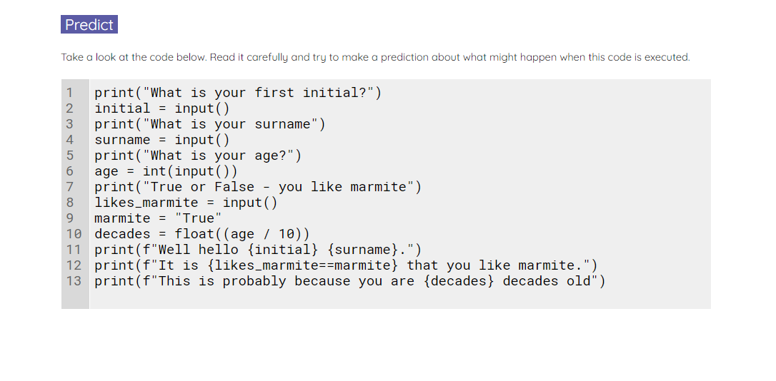
Mini data collection program
Use the worksheet to predict, run, and investigate the code for a mini data collection program.
An explorer task has been provided on the sheet if you require this.
Notes:
A3 Worksheet – Mini data collection program

Slide 67
Match the data types to their examples
Boolean
“a”
String
5.2
Char
“Hello”
Real/float
283
Integer
False

Slide 68
Match the data types to their examples
Boolean
“a”
String
5.2
Char
“Hello”
Real/float
283
Integer
False

Slide 69
Match the data types to their examples
Boolean
“a”
String
5.2
Char
“Hello”
Real/float
283
Integer
False

Slide 70
Match the data types to their examples
Boolean
“a”
String
5.2
Char
“Hello”
Real/float
283
Integer
False

Slide 71
Match the data types to their examples
Boolean
“a”
String
5.2
Char
“Hello”
Real/float
283
Integer
False

Slide 72
Match the data types to their examples
Boolean
“a”
String
5.2
Char
“Hello”
Real/float
283
Integer
False

Slide 73
Learning Outcomes
Now, you should be able to:
Understand the Basic Components of Software Architecture
Understand different data types
Differentiate Between Various Software Architecture Patterns
Evaluate the Impact of Architecture Elements on Software Quality

Slide 74

Questions?

Slide 75
Thank You

